Slide 1


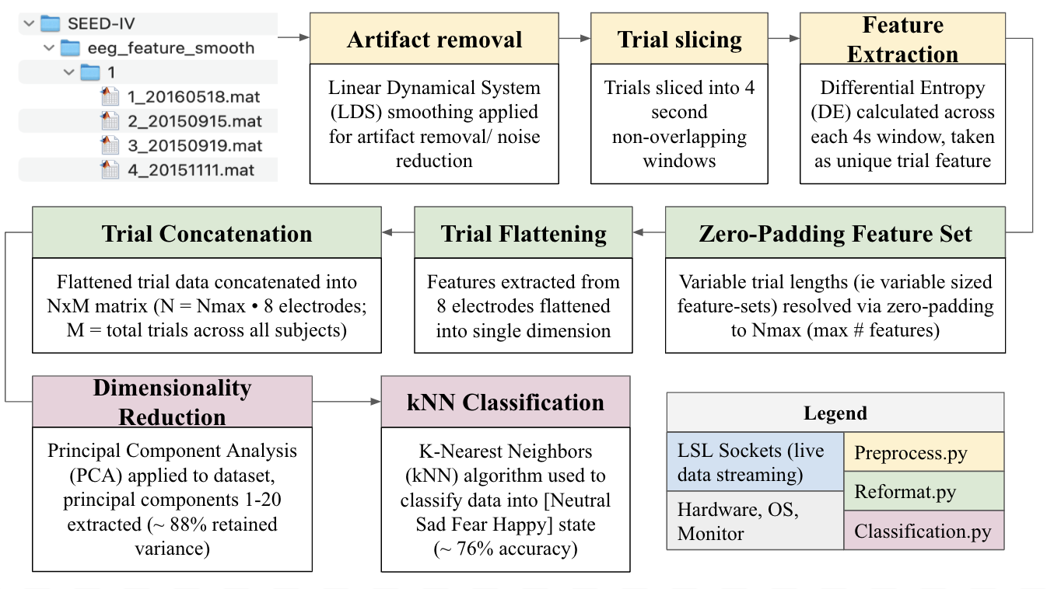
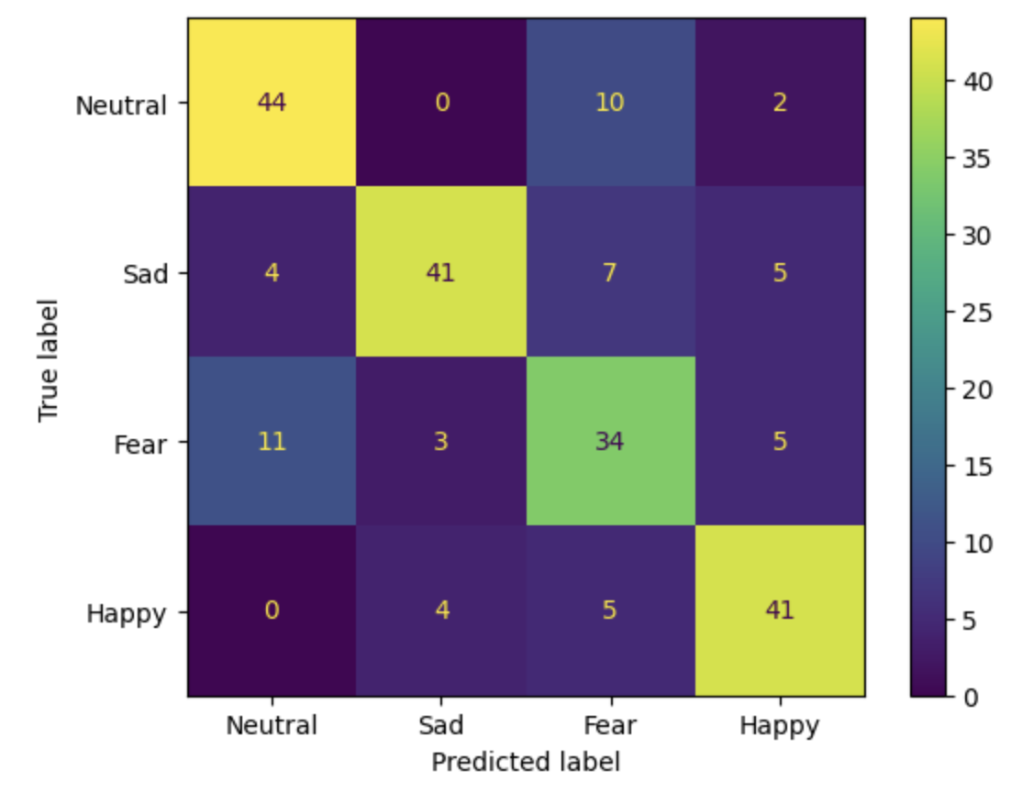
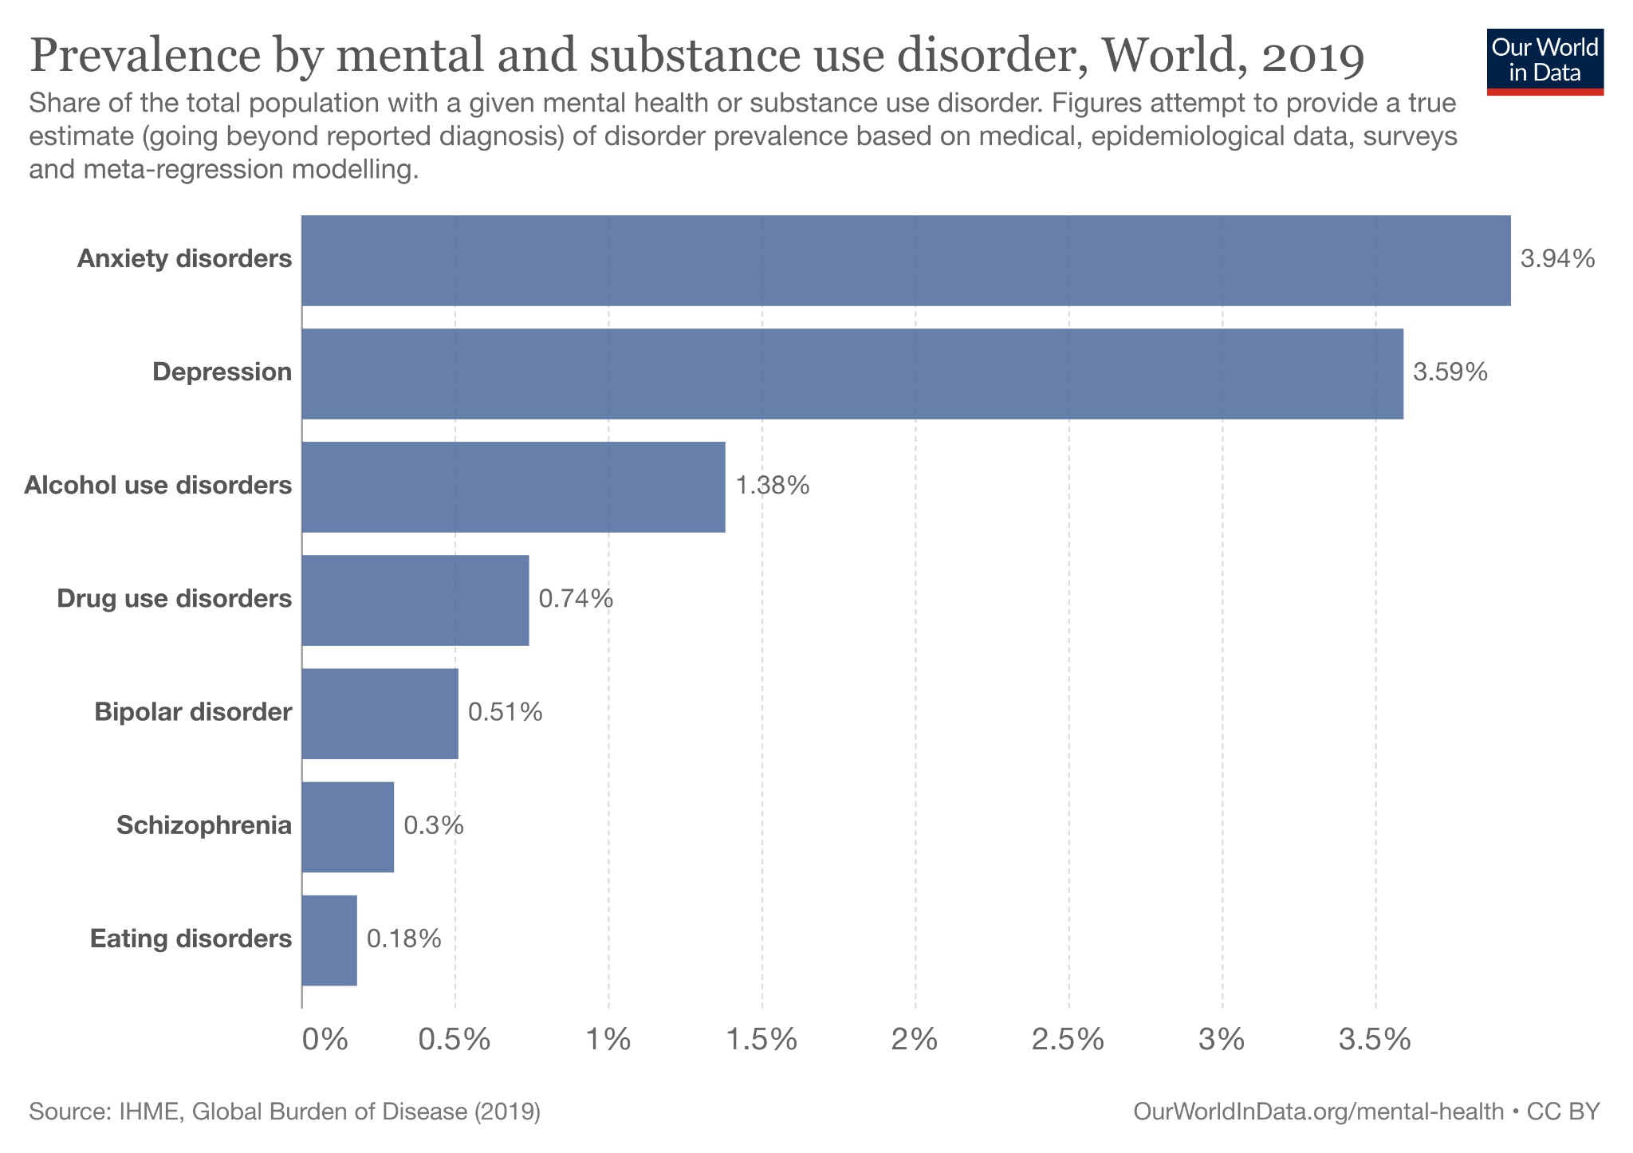
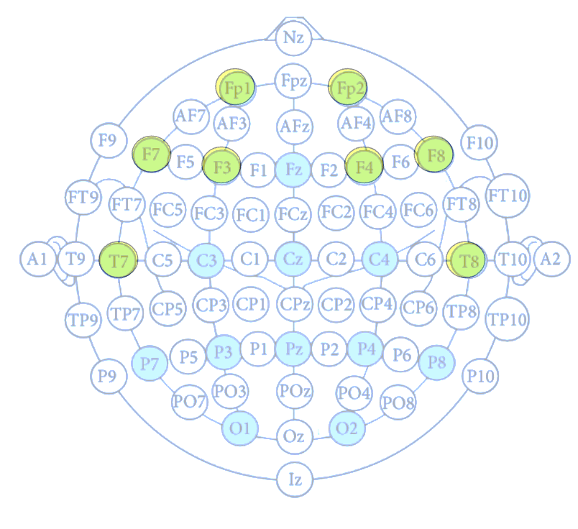
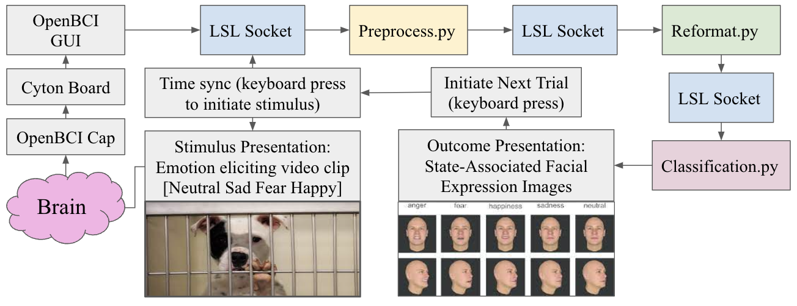
EEG-Based Emotion Classification for Emotion Recognition Behavioral Therapy
Alexandru Georgescu, Anushka Narasani, Ashley Wang, Fazil Onuralp Ardic, and Davis Sandberg
Abstract
Methods
Preliminary Results
Facial Expression Recognition (FER) deficit is one of most common cognitive impairments
ER and FER associated with subjective emotional experience, not facial expression mis-encoding
EEG-Based Emotion Classifier (Model Training):
kNN Confusion Matrix:
76.06% Accuracy
Fp1, Fp2, F3, F4, F7, F8, T7, T8
Emotion Classifier + GUI Integration (Live-streamed data):
Next Steps
Significance
FER deficit is a feature of depression, anxiety, schizophrenia, autism, substance use disorders
Objective: Integrate FER training with subjective emotion experiences to:
(1) Improve association between subjective and perceived emotion identification
(2) Better understand affective state and emotion biases in affected individuals.
Search for higher accuracy classification algorithms
Adapt the data-processing pipeline to our collected data
Develop GUI for real-time classification
Acknowledgements
Thank you Dr. William Speier and Bill Wu
Notes:
Established feature of depression, anxiety, schizophrenia, autism, and substance abuse disorders

Slide 2
EEG-Based Emotion Classification for Behavioral Therapy
BCI TEAM 4

Slide 3
Narrative:
Facial Expression Recognition (FER) deficit is one of most common cognitive impairments
FER deficit is a feature of depression, anxiety, schizophrenia, autism, substance use disorders

Slide 4

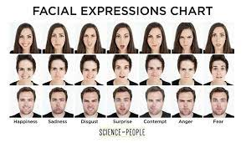
Significance:
Emotion Recognition (ER) and FER associated with subjective emotional experience, not facial expression mis-encoding
Objective: Integrate FER training with subjective emotion experiences to:
(1) Improve association between subjective and perceived emotion identification
(2) Better understand affective state and emotion biases in affected individuals.

Slide 5

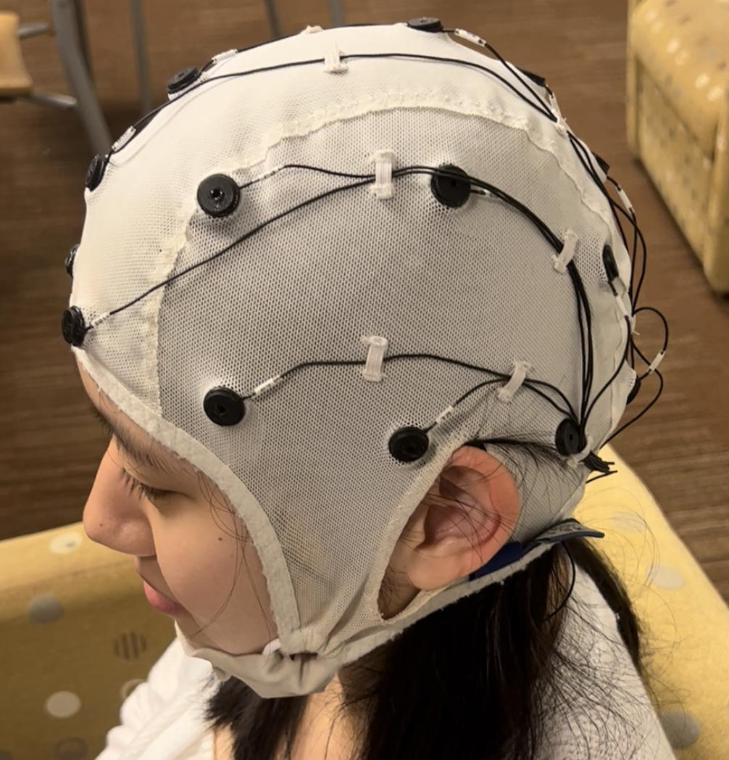
Data Collection:
Fp1, Fp2, F3, F4, F7, F8, T7, T8

Slide 6
Specific Aim 1:
Develop emotion-classifier

Slide 7
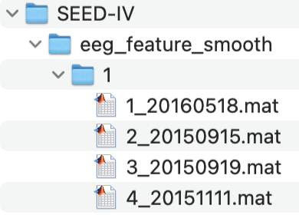
Model Training:
Artifact removal
Trial slicing
Feature Extraction
Linear Dynamical System (LDS) smoothing applied for artifact removal/ noise reduction
Trials sliced into 4 second non-overlapping windows
Differential Entropy (DE) calculated across each 4s window, taken as unique trial feature
Trial Concatenation
Trial Flattening
Zero-Padding Feature Set
Flattened trial data concatenated into NxM matrix (N = Nmax • 8 electrodes; M = total trials across all subjects)
Features extracted from 8 electrodes flattened into single dimension
Variable trial lengths (ie variable sized feature-sets) resolved via zero-padding to Nmax (max # features)
Dimensionality Reduction
kNN Classification
Legend
Principal Component Analysis (PCA) applied to dataset, principal components 1-20 extracted (~ 88% retained variance)
K-Nearest Neighbors (kNN) algorithm used to classify data into [Neutral Sad Fear Happy] state
(~ 76% accuracy)
LSL Sockets (live data streaming)
Preprocess.py
Reformat.py
Hardware, OS, Monitor
Classification.py

Slide 8
Specific Aim 2:
Interactive GUI Integration

Slide 9
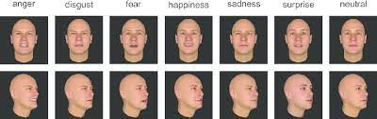
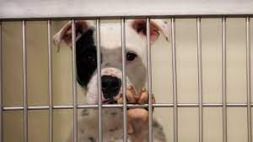
Aim #2: Integrated GUI/ Interactive Module
OpenBCI GUI
LSL Socket
Preprocess.py
LSL Socket
Reformat.py
Cyton Board
Time sync (keyboard press to initiate stimulus)
Initiate Next Trial (keyboard press)
LSL Socket
OpenBCI Cap
Stimulus Presentation: Emotion eliciting video clip [Neutral Sad Fear Happy]
Outcome Presentation: State-Associated Facial Expression Images
Classification.py
Brain

Slide 10
Preliminary Results
kNN Confusion Matrix
kNN Accuracy: 76.06%
SVM Accuracy: 68.02%

Slide 11
Next Steps:
Search for higher accuracy classification algorithms
Adapt the data-processing pipeline to our collected data
Develop GUI for real-time classification

Slide 12
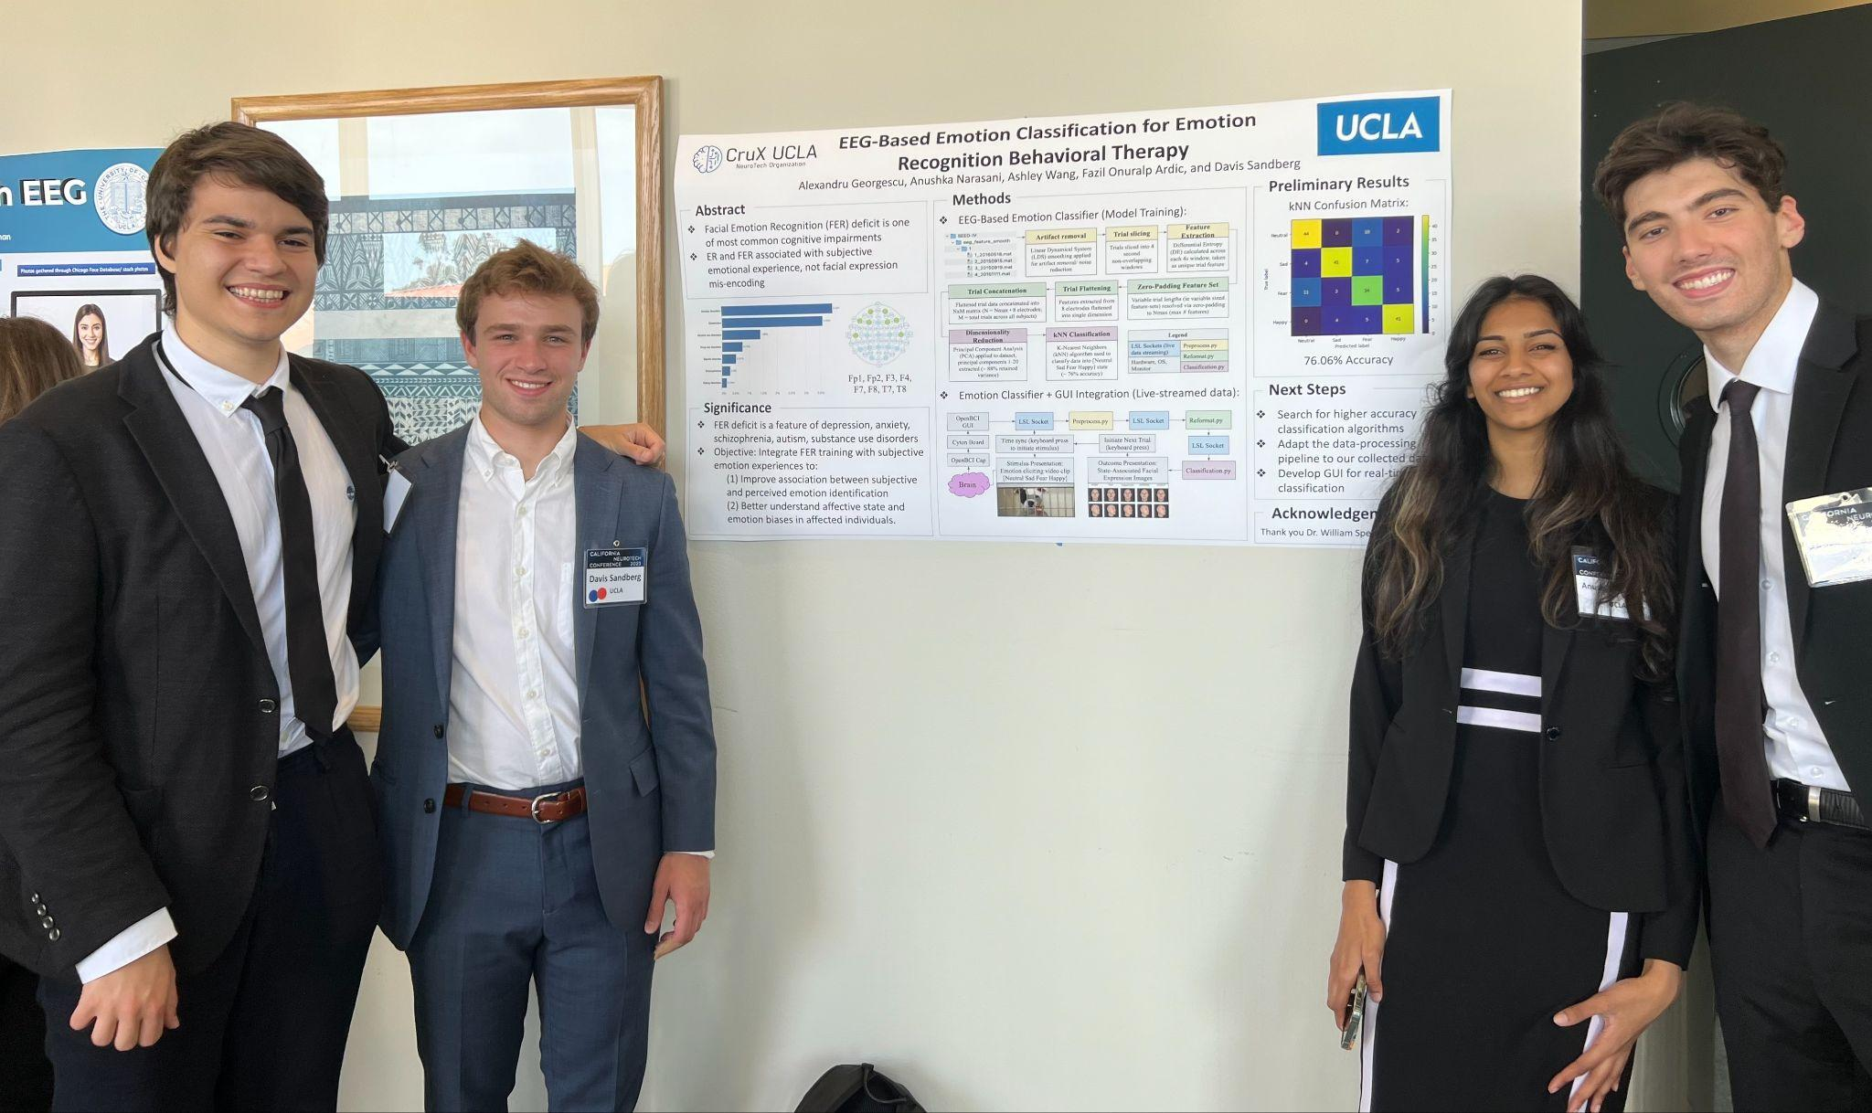
Acknowledgements
Thank You:
Bill Wu
Dr. Bill Speier
CruX Board
Team Lead:
Davis Sandberg
Contributing Members:
Onuralp Ardic
Alex Georgescu
Anushka Narasani
Ashley Wang

Slide 13
Artifact removal
Trial slicing
Feature Extraction
Linear Dynamical System (LDS) smoothing applied for artifact removal/ noise reduction
Trials sliced into 4 second non-overlapping windows
Differential Entropy (DE) calculated across each 4s window, taken as unique trial feature
Trial Concatenation
Trial Flattening
Zero-Padding Feature Set
Flattened trial data concatenated into NxM matrix (N = Nmax • 8 electrodes; M = total trials across all subjects)
Features extracted from 8 electrodes flattened into single dimension
Variable trial lengths (ie variable sized feature-sets) resolved via zero-padding to Nmax (max # features)
Dimensionality Reduction
kNN Classification
Legend
Principal Component Analysis (PCA) applied to dataset, principal components 1-20 extracted (~ 88% retained variance)
K-Nearest Neighbors (kNN) algorithm used to classify data into [Neutral Sad Fear Happy] state
(~ 76% accuracy)
LSL Sockets (live data streaming)
Preprocess.py
Reformat.py
Hardware, OS, Monitor
Classification.py

Slide 14
