Slide 1
ECOFIT
Onuralp Ardic, Gabriel Jiang, Yassin Kortam, Hana Lesaicherre, Nathan Nguyendinh

Slide 2
PRoblem and need
PROBLEM: We all have daily habits that are bad for the environment.
Need: Encouragement to change them.

Slide 3
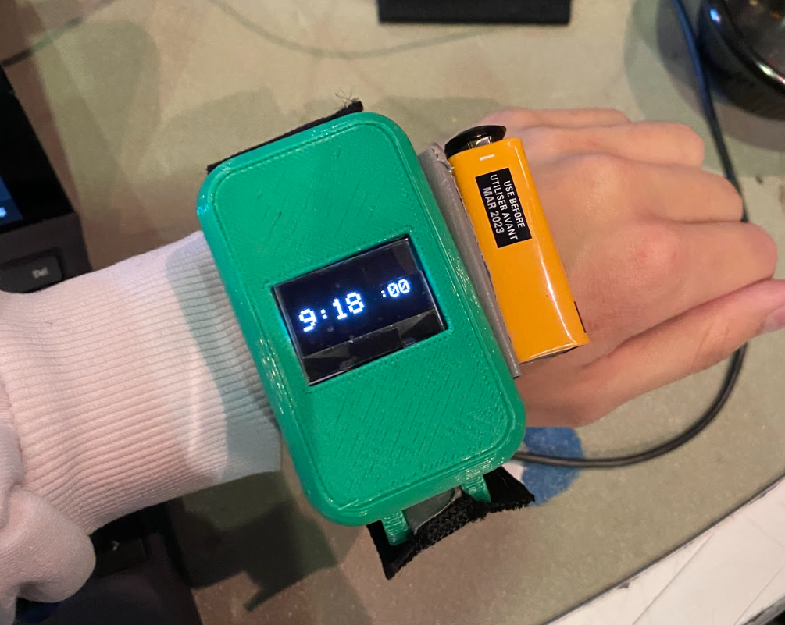
Where we come in
Our product, ECOFIT, is a smart watch that tracks sustainable habits (ex: walking instead of driving)

Slide 4
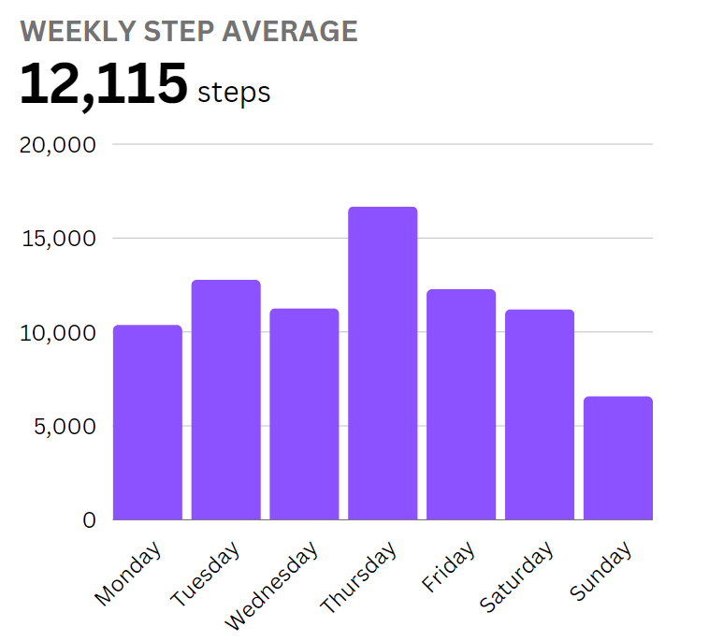
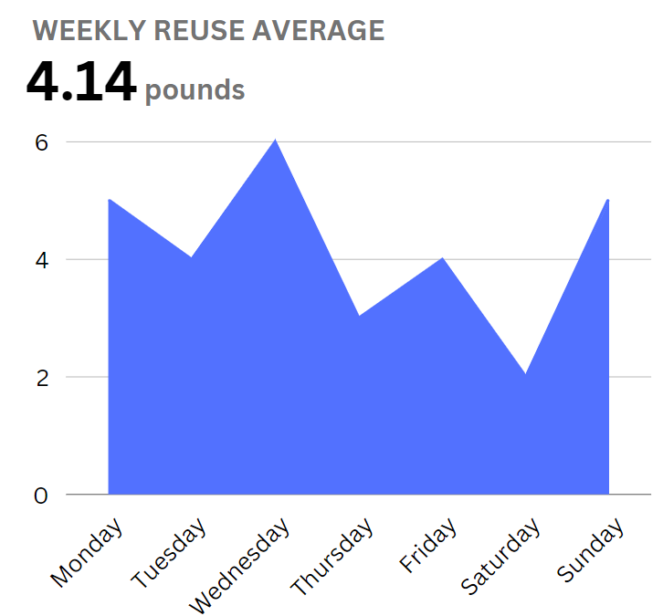
SOlution
A wearable device that:
tracks sustainable habits
Tracks the use of reusable containers
Tracks commuting habits
All with only a gyroscope and accelerometer

Slide 5
Architecture
Uploads user data to the cloud for viewing on any mobile device
Event driven architecture
Intermediary between wearable and cloud for data analysis pipeline
ECOFIT
User device
Mongo DB
Web Client

Slide 6
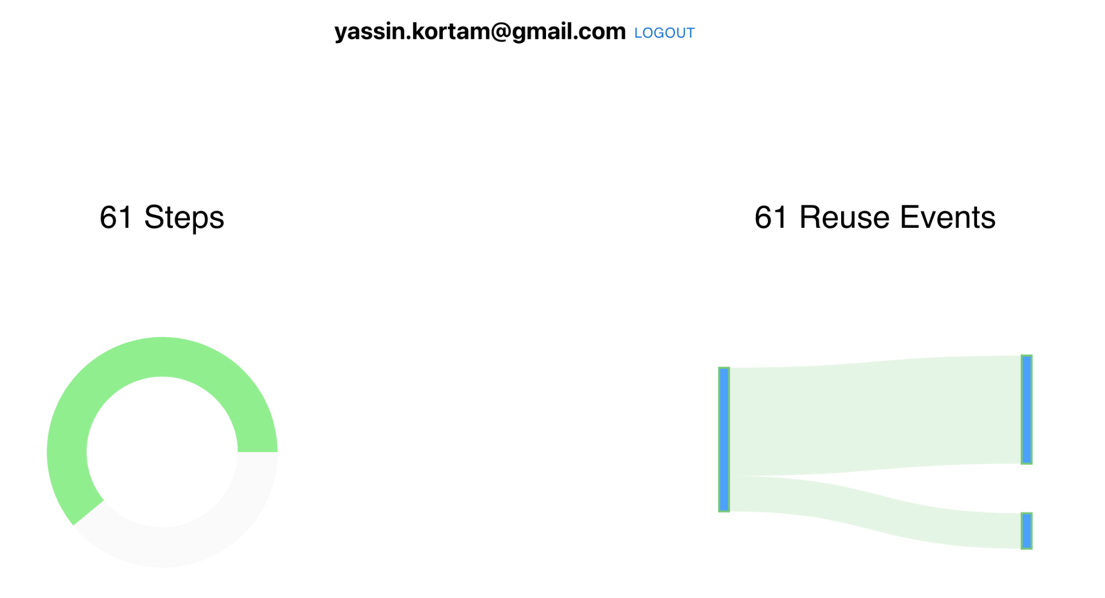
Notes:
Maybe mention our idea of gathering the data so every user can compete with each other to further encourage environmental friendly actions?

Slide 7
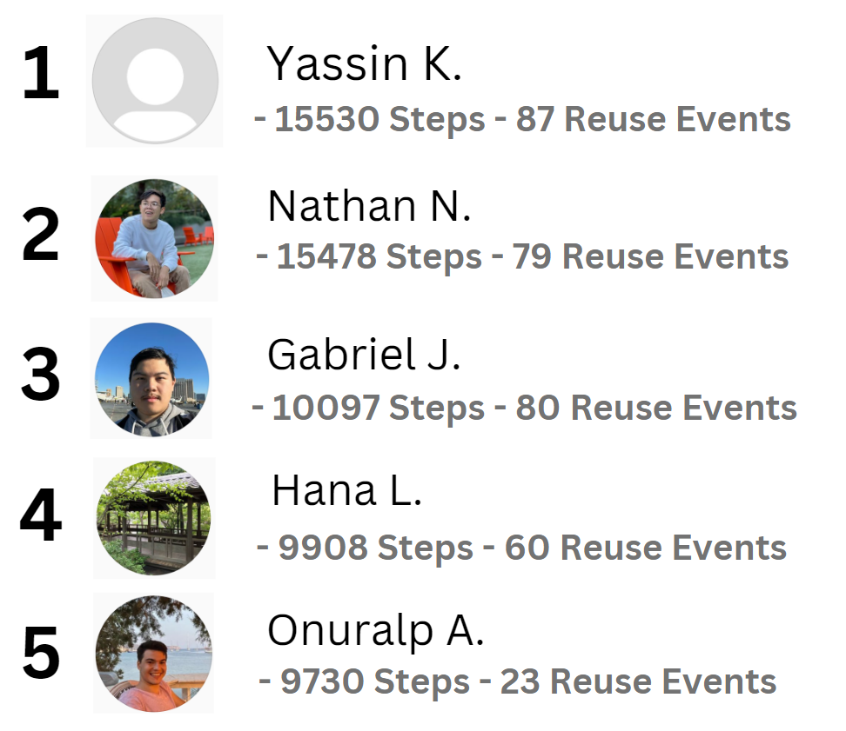

Slide 8
Simplifications
The data analysis pipeline is on a local computer
Events are detected through gestures associated with sustainable habits
  Reusable containers means washing dishes
  Sustainable commuting means walking
  Future applications for ml

Slide 9
ConClusion
ECO-FIT will promote environmentally sustainable habits in users, helping us leave this world better than we found it!
Future iterations will feature:
More sleek, compact design
Wider array of recognized actions
Improved recognition of motions
Please check out our website for more information!
https://devpost.com/software/ecofit-9kayne

Slide 10
THANK YOU!

